Slide 1
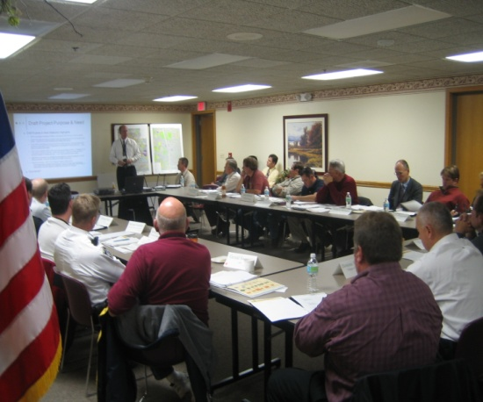
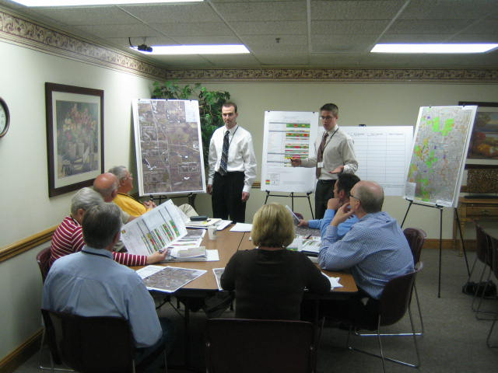
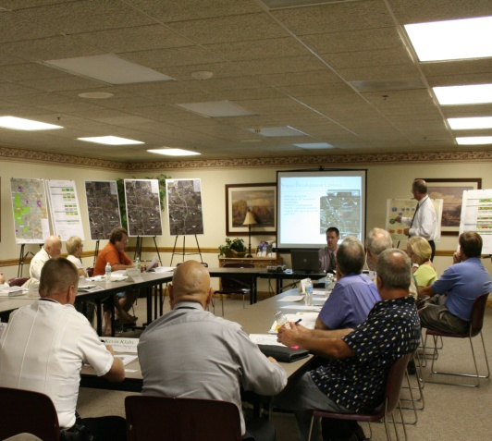
Community Advisory Group Meeting #1
(June 16, 2009)
Project overview and review NEPA project development procedures
Review Public Involvement Plan and the Community Advisory Group (CAG) role and objectives
Review March 3, 2009 Public Meeting results on project issues and concerns survey
Develop CAG Project Problem statement as input to Project Purpose and Need Statement
Community Advisory Group Meeting #2
(November 3, 2009)
Review the project Purpose and Need Statement
Discuss Bypass Alternatives Analysis Process and Methodology
Workshop: CAG Input on screening full range of 18 initial Bypass alternatives to 9 reasonable alternatives for concept development and evaluation
Community Advisory Group Meeting #3
(April 27, 2010)
Review the development process and results for the 9 concept bypass alternatives
Review the evaluation results for the 9 bypass alternatives with respect to transportation performance, environmental impacts, and cost
Workshop: CAG input on further screening of the 9 Bypass alternatives to the finalist alternatives based on development and evaluation results
Community Advisory Group Meeting #4
(August 19, 2010)
Presentation of the 3 Finalist Bypass Alternatives determined by the Project Study Group based on results from the 3rd CAG meeting and coordination/concurrence from FHWA and other jurisdictional Resource Agencies (IHPA, ACOE, USEPA, ILEPA, IDNR, USFWS, etc)
Preview of Public Meeting #2
Discussion of remaining project development procedures after Public Meeting #2
Community Advisory Group Meeting #5
(July 26, 2011)
Presentation of the Selected West Bypass Alternative (A4) by the Project Study Group
Review factors considered in the selection
Review the remaining analysis of the Selected West Bypass Alternative
Workshop: CAG input on design elements of the Selected West Bypass Alternative
Millburn Bypass
Community Advisory Group

